Slide 1

Enterprise Information Systems
ERP SYSTEMS AND BLOCKCHAIN TECHNOLOGY OF STARBUCKS
Student ID | Student Name
10612366 | Navin Kumar Singupuram
10508676 | Digvijay Jatkar
10612648 | Febin Babu Skariya
Wednesday, March 29, 2023
B9IS105 Enterprise Information System, Dublin Business School

Slide 2



Agenda
Introduction
Financial Performances of Star Bucks
Methodology Used
Challenges Faced
Solutions
The Effectiveness of The ERP System at Starbucks
Data Gathering
Data Analysis
Themes and Questions
Block Chain Technology at Starbucks
Challenges Faced
Starbucks utilizing block chain technology and solutions
Recommendations

Slide 3




INTRODUCTION
The presentation provides an overview of supply chain management process difficulties and how Starbuck’s overcame them using ERP and block chain technology.
These technologies have affected Starbucks' operations, including how they have affected the effectiveness of the supply chain, the quality of the products, and the customer experience.
Starbucks utilized enterprise resource planning (ERP) systems to coordinate and control key business operations like finance, supply chain management, and customer relations.
Starbucks had a difficult time managing its intricate supply chain and safeguarding customer information and they have used block chain technology at Starbucks to improve supply chain transparency and data privacy.
Wednesday, March 29, 2023

Slide 4

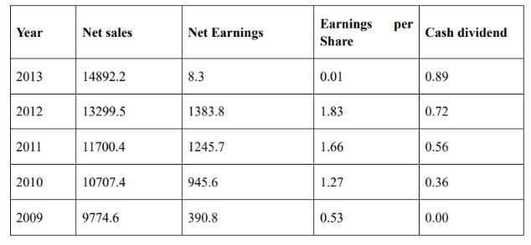
Financial Performances of Starbuck’s
The corporation launched an aggressive growth strategy to improve its operations and workspaces globally.
Relationships with CI (conservation international), programs to empower young employees, and the launch of Starbucks University are among the company's main accomplishments.
(All figures in Millions)
Wednesday, March 29, 2023

Slide 5
Methodology
For the Starbucks case study, data was gathered from a variety of sources, including key stakeholder interviews, document and report analysis, and on-site observations of the ERP system.
A qualitative research methodology was used to analyze the data, which includes looking for patterns, themes, and trends.
Supply chains, finance, procurement, and project management are just a few of the routine business tasks that Starbucks employs an Oracle ERP system to handle.
Starbucks has employed the ERP (enterprise resource planning) dashboards to evaluate current business performance relative to defined goals and pinpoint opportunities for improvement. These dashboards are used as a decision support system to depict changes in production and business operations.
Starbucks used the Online Analytical Processing tool to perform the statistical and huge data analysis that served as a valuable tool to manage decision-making.
Wednesday, March 29, 2023

Slide 6
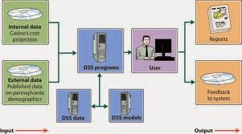
Decision Supporting System Flow
To help users more readily make business decisions, the DSS is a computer algorithm program that analyzes and shows business data.
Starbucks' parent business in the USA employs only one DSS system, called "oracle." Oracle produces monthly reports that serve as the foundation for significant decisions.
Wednesday, March 29, 2023
B9IS105 Enterprise Information System, Dublin Business School

Slide 7
PROBLEM STARBUCKS WAS FACING BEFORE USING ERP
Rapid expansion and changing consumer preferences.
Oversaturation in some markets, which led to declining sales and increased competition
Starbucks had been expanding aggressively into new markets and introducing new products and services, which created some operational challenges related to supply chain management, inventory control, and employee training
Another challenge that the company faced was growing consumer demand for healthier and more socially responsible products, which led Starbucks to introduce new products and initiatives to address these concerns
Wednesday, March 29, 2023
B9IS105 Enterprise Information System, Dublin Business School

Slide 8
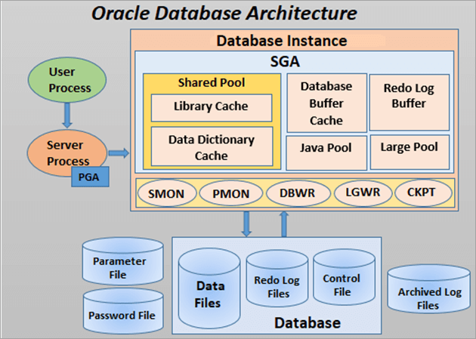
Why Oracle?
Oracle technology was used in the construction of Starbucks' point-of-sale data warehouse.
With the help of this foundation and the Oracle OLAP option on the Oracle Exadata Database Machine, Starbucks was able to scale and easily switch from its prior Oracle-based data warehouse to Oracle Exadata to gain more insight and hasten decision-making despite the enormous growth of the data and users.
Wednesday, March 29, 2023
B9IS105 Enterprise Information System, Dublin Business School

Slide 9
Challenges Faced
To facilitate better-informed business choices at the corporate, regional, and store levels, develop a strong, continuously accessible enterprise data warehouse with data on supply chain, sales, marketing, and retail management.
To keep driving innovation, enhance the capacity for quick analysis and action on supply chain information, customer loyalty, and coffee sales data.
Guarantee scalability to accommodate the volume of data's rapid expansion.
Wednesday, March 29, 2023
B9IS105 Enterprise Information System, Dublin Business School

Slide 10
Challenges to drive
Rapid expansion and changing consumer preferences.
Oversaturation in some markets, which led to declining sales and increased competition
Starbucks had been expanding aggressively into new markets and introducing new products and services, which created some operational challenges related to supply chain management, inventory control, and employee training
Another challenge that the company faced was growing consumer demand for healthier and more socially responsible products, which led Starbucks to introduce new products and initiatives to address these concerns
Wednesday, March 29, 2023
B9IS105 Enterprise Information System, Dublin Business School

Slide 11
Solutions using Oracle Exadata
Oracle Exadata Database Machine and Oracle Business Intelligence Enterprise Edition are used to implement the corporate intelligence and warehouse environment that can provide analysts and managers at corporate levels to give useful insight and information on the performance of products and stores for supply chain-driven work.
Added the capability of loading and refreshing data from all stores in time for shop openings, concluding full loads in under four hours, and accomplishing service level agreements aided the company in implementing daily consumer loyalty and point-of-sale data
For speedy and intricate analytics, the Oracle OLAP functionality was employed to make 1-terabyte cubes available built a front-end dashboard with key business metrics that can be seen by 10,000 people, including shop and corporate management, to quickly access operational and sales data at the shop level
Wednesday, March 29, 2023
B9IS105 Enterprise Information System, Dublin Business School

Slide 12
Solutions Analysis
Product analysts' increased understanding of consumer preferences will help with strategic planning and new product introductions.
Store managers' weekly report-writing time will be cut by hours, and thousands of stores will benefit from the increased insight and better decision-making at the same time.
Oracle Partitioning was used to enhance data storage management and cost-effectiveness.
Wednesday, March 29, 2023
B9IS105 Enterprise Information System, Dublin Business School

Slide 13
Oracle ERP features that helped Starbucks
Financial planning and analysis
Order management
Risk management
Compliance and governance
Inventory and supply chain
Project planning and execution
Accounting
Financial close and Product lifecycle
Revenue recognition
Wednesday, March 29, 2023
B9IS105 Enterprise Information System, Dublin Business School

Slide 14
Oracle Products and Services by starbucks
Oracle Database 12c comes with a world-class multidimensional analysis engine called Oracle OLAP.
Oracle OLAP cubes produce results with reaction times that are second to thought utilizing simple SQL queries to do complex calculations.
Analytical measures such as time-series computations, financial models, predictions, allocations, regressions, and more are simple to develop using Oracle OLAP.
In Oracle OLAP cubes, dimension views are arranged in a constellation around the cube (or fact) view using a star schema architecture
Wednesday, March 29, 2023
B9IS105 Enterprise Information System, Dublin Business School

Slide 15
Oracle OLAP Benefits
With Oracle OLAP you can:
Create a multidimensional model with ease using sophisticated analytical computations
Provide powerful analytics to any reporting and analytical application in a productive manner using simple SQL.
Transparently enhance summary queries against tables by utilizing materialized views based on cubes
Useful in integrating the own OLAP data with any other data such as XML
Use current knowledge of and expenditure in Oracle db software.
Wednesday, March 29, 2023
B9IS105 Enterprise Information System, Dublin Business School

Slide 16
Database Machine Benefits
Best Data Warehouse platform:
For quicker access to business-critical data, run more queries concurrently and increase data warehouse query performance by a factor of 10 or more.
Best OLTP platform:
Combine massive physical flash with super-fast flash compression and clever flash caching algorithms that can provide millions of I/Os per second to boost the performance of OLTP-focused applications.
Best Consolidation platform:
Discrete special-purpose systems should be replaced with a unified platform that provides industry-leading performance and scalability for all database applications. As requests flow from database servers to network adapters and switches, to storage, and back again, Exadata can transparently prioritize them.
Wednesday, March 29, 2023
B9IS105 Enterprise Information System, Dublin Business School

Slide 17
Word in the press
A word from THE Starbucks Coffee Company
"Our Oracle Exadata-based database warehouse and Oracle Business Intelligence environment deliver detailed insight into point-of-sale data that allows us to innovate and offer our customers better services." – Mike Manzano, Vice President, Analytics and Insight, Starbucks Coffee Company.
Wednesday, March 29, 2023
B9IS105 Enterprise Information System, Dublin Business School

Slide 18
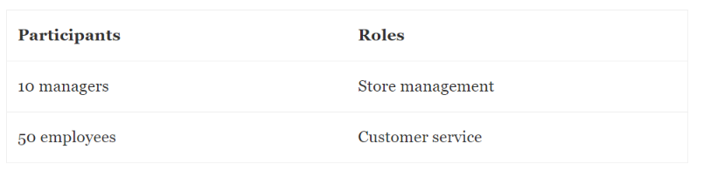
The Effectiveness of The ERP System at Starbucks
Surveys of Starbucks store managers and technical specialists were used to gather the primary data on the company's ERP system.
While choosing the shops and the people from which to collect data, the researcher used a random sample procedure. 50 Starbucks employees and 10 managers made up the final sample.
By administering questionnaire surveys to the sample members, the primary data were obtained.
Only 34 employees and 7 managers completed the surveys and returned them out of the 60 participants to whom it was given. Seven employee questionnaires were returned unanswered because they were incomplete. The managers' questionnaires were all fully completed. So, a sample of 7 managers and 27 employees served as the basis for the data used in the study.
Wednesday, March 29, 2023
B9IS105 Enterprise Information System, Dublin Business School

Slide 19
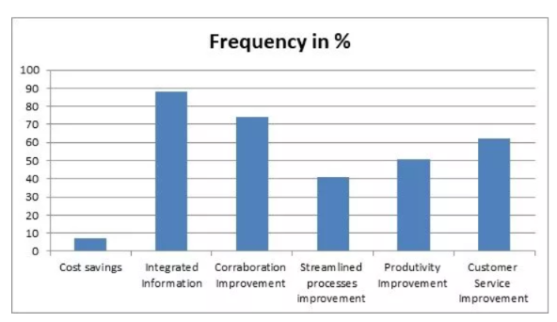
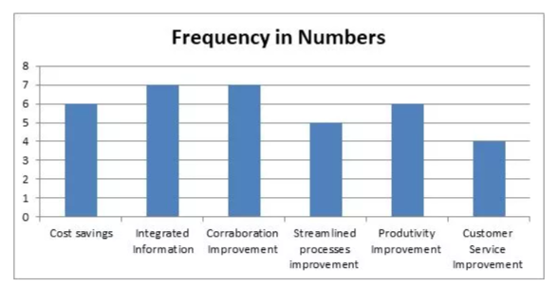
Themes of the Questionnaire
Question 1: Benefits of ERP system in Starbucks
The graphs below illustrate how frequently both managers and employees mentioned the aforementioned themes
Employees' frequency of themes
The managers' recurrence of themes
Wednesday, March 29, 2023
B9IS105 Enterprise Information System, Dublin Business School

Slide 20
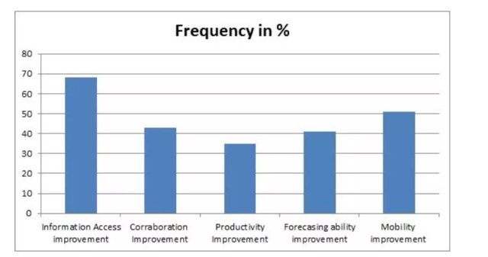
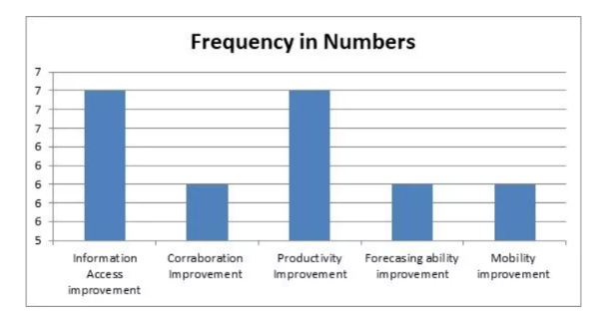
Themes of the Questionnaire
Question 2: How ERP system affects the work
Enhancing information availability, correlating information, predicting outcomes, raising productivity, and enhancing mobility were the key subjects discussed. Figures 4.0 and 5.0, respectively, indicate the frequency
Frequency among the workforce
Frequency of the themes among the managers
Wednesday, March 29, 2023
B9IS105 Enterprise Information System, Dublin Business School

Slide 21
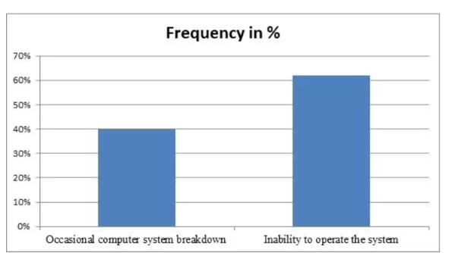
Themes of the Questionnaire
Question 3: IMPLICATIONS/WEAKNESSES OF THE ERP SYSTEM
Regarding Starbucks' ERP system's flaws or problems, only two prevalent themes emerged: intermittent computer system failure and some employees' incapacity to use it
Frequencies among the employees
Wednesday, March 29, 2023
B9IS105 Enterprise Information System, Dublin Business School

Slide 22
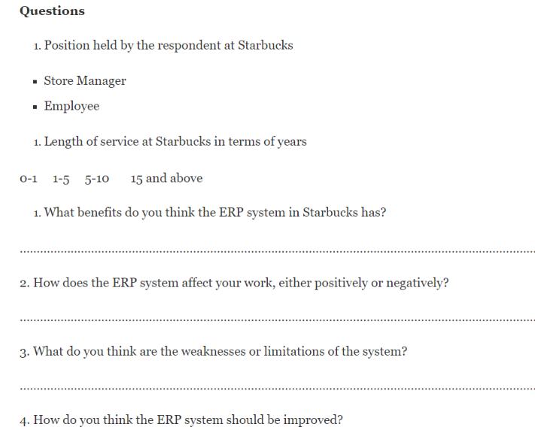
Themes of the Questionnaire
Question 4: Suggested improvements to the system
The managers claimed that the system improved their ability to coordinate with both the staff and other supervisors.
Cost savings receives very little attention from the staff, perhaps because they are not directly involved in cost control.
Due to their closer involvement in servicing customers than management, employees gave customer service a reasonably good rating.
Wednesday, March 29, 2023
B9IS105 Enterprise Information System, Dublin Business School

Slide 23
BlockChain Technology
The report makes the case that by enabling the tracking of coffee beans from the farm to the coffee shop, block chain technology can improve the transparency of Starbucks' supply chain.
The study also covers the management of Starbucks' loyalty rewards program using block chain technology. Starbucks may make sure that rewards points are tracked accurately and that they are simple for customers to use by utilizing block chain technology.
The necessity of data privacy in the digital era is emphasized in the report's conclusion, along with some ways that block chain technology can assist in safeguarding user data.
Customers can use the recently launched service, which employs blockchain technology, to scan a code on the back of a bag of coffee beans to get information on the country, a specific farm or farms, and the farmers who created the product.
Wednesday, March 29, 2023
B9IS105 Enterprise Information System, Dublin Business School

Slide 24
Challenges faced by starbucks
Lack of transparency:
Starbucks may find it challenging to trace the origin and quality of the coffee beans due to the complexity of the coffee supply chain. It may be difficult for Starbucks to uphold fair trade principles and win over customers due to this lack of openness.
Traceability:
It can be difficult for Starbucks to guarantee the quality and authenticity of the coffee beans due to a lack of traceability in the coffee supply chain. It may be difficult to stop supply chain fraud, counterfeiting, and other illicit actions as a result of this lack of traceability.
Security:
Fraud and other security vulnerabilities may make the coffee supply chain more susceptible, which could jeopardize its integrity. Starbucks may have encountered difficulties in maintaining the authenticity of its coffee beans and ensuring the security of its supply chain.
Wednesday, March 29, 2023
B9IS105 Enterprise Information System, Dublin Business School

Slide 25
Challenges faced by starbucks
Operational inefficiencies:
There may be delays, mistakes, and increased costs as a result of the coffee supply chain's potential slowness and inefficiency. Starbucks may have had difficulties in simplifying its supply chain and lowering transaction costs and times.
Technical barriers:
It can be difficult to implement blockchain technology, and it might need a lot of technical resources. Finding the best IT partners and incorporating blockchain technology into Starbucks' current supply chain management systems may have been difficult tasks.
Wednesday, March 29, 2023
B9IS105 Enterprise Information System, Dublin Business School

Slide 26
Starbucks utilizing blockchain technology and solutions
Starbucks tracked the origin and quality of the coffee beans by using blockchain technology to create a transparent and impenetrable record of the coffee supply chain. By doing this, Starbucks can assure fair trade practices and increase customer confidence.
Starbucks can monitor the path of the coffee beans from the farm to the cup using blockchain technology, creating a trustworthy and auditable record of the supply chain. By doing this, Starbucks can guarantee the high quality and originality of the coffee beans, stop fraud and counterfeiting, and adhere to legal requirements.
Starbucks may use blockchain technology to create a safe and impenetrable record of the coffee supply chain, lowering the risk of fraud and other security concerns. By doing this, Starbucks can increase customer confidence and safeguard the authenticity of its coffee beans.
Wednesday, March 29, 2023
B9IS105 Enterprise Information System, Dublin Business School

Slide 27
Starbucks utilizing blockchain technology and solutions
The coffee supply chain can be streamlined using blockchain technology, which will cut down on transaction costs and time while increasing chain efficiency. By doing this, Starbucks may be able to lower expenses and increase customer happiness.
By collaborating with tech firms with knowledge of supply chain management systems and blockchain technology, Starbucks can overcome technical obstacles. Starbucks can also spend money on training and development to create internal blockchain technology knowledge.
By generating a transparent and irreversible record of consumer transactions and rewards, blockchain technology can improve Starbucks' loyalty programs and offer customers a more effective and secure payment mechanism.
Wednesday, March 29, 2023
B9IS105 Enterprise Information System, Dublin Business School

Slide 28
Conclusion and recommendations
Improve in decision support system - use of WebEx weboffices - focused on communication - employ data-driven - webfocus - utilize document-driven Captaris process
A crucial benefit of information integration is that it empowers managers to take wise decisions. Like other worldwide organizations, Starbucks has put the system into place
Wednesday, March 29, 2023
B9IS105 Enterprise Information System, Dublin Business School

Slide 29
Conclusion and recommendations
Given that the ERP system benefits the business, the managers, and the employees, it is clear from the Starbucks study that it is effective. The study's findings only mention two problems: some staff lack proper training on how to utilize the system, and the computer systems that power the ERP systems occasionally malfunction.
The coffee supply chain could be transformed by blockchain technology by increasing accountability, openness, and traceability. Starbucks has acknowledged how using block chain technology can help the company meet its environmental objectives and win its customers' trust
Starbucks has improved greatly since its early systems, which were inefficient and raised costs. If Starbucks is to take use of the IS technology that is presently available on the market, there is still a long way to go
Wednesday, March 29, 2023
B9IS105 Enterprise Information System, Dublin Business School

Slide 30


Thank You
Wednesday, March 29, 2023
B9IS105 Enterprise Information System, Dublin Business School

